Slide 1
Developing a partner reward strategy – to build competitive advantage
Peter Scott
Peter Scott Consulting
www.peterscottconsult.co.uk

Slide 2
For law firms in the future ....
Achieving high performance will matter as never before if they are to:
- be competitive
- exploit market opportunities

Slide 3
To do this law firms will need to focus on…
PETER SCOTT CONSULTING
Getting the best performance from their people
Helping people to maximise their potential
How skilled are law firms at getting the
best from their people?
Notes:
3

Slide 4
Building competitive advantage over rivals requires ....
Consistent delivery of what clients require – and better than rivals
if client satisfaction is valued by a firm, then that should determine what it takes to succeed at the firm
Success will depend on the ability to attract, retain and develop ‘key people’ who are outstanding performers
But will what is valued be rewarded?
And how will it be rewarded?

Slide 5
Driven by market considerations
If a firm is unable to offer competitive rewards in the market
It risks losing its best people
It will be unable to recruit the best

Slide 6
Competitive rewards are personal
Examples:
Reputation / profile of firm
Defined vision and strategy
culture
Money
Career
Quality of work / clients
Feeling valued / relative worth
Am I in the wrong firm?

Slide 7
Why partners switch firms…
Personal reasons
Total number of mentions
Number of times as 1st or 2nd reason
Pushed out
Profile of firm
Equity sooner
Culture of firm
More opportunity
Quality of work
Financial

Slide 8
Worth
‘I am not being paid what I am worth’
Do not underestimate the importance of the need to feel ‘valued’
Not always wholly financially driven

Slide 9
Relative worth
‘I am worth more than he is’
How to determine the relative contribution of each partner with respect to other partners?

Slide 10
What should a partner reward system aim to achieve?
Be aligned with a firm’s strategic goals
Help create a culture of performance to build competitive advantage over rivals
Provide financial rewards which recognise each individual’s ‘worth’
Encourage / develop new skills within the firm

Slide 11
But to achieve this…
Will involve overcoming hurdles to change
Will take time
Will require courage, vision and leadership

Slide 12
Average partner profitability is key
No reward system can make up for a lack of profitability
What is the markets average PEP threshold?
Below that threshold a firm is ‘at risk’

Slide 13
Partner reward – which system?
No such thing as a perfect system
One which works well for one firm may be a disaster for another firm
A system should be a ‘living document’ to meet the changing needs of the firm
Many systems undergo minor refinements e.g. changing criteria each year

Slide 14
Which system?
Lockstep?
or
Performance?
or
A mixture?

Slide 16
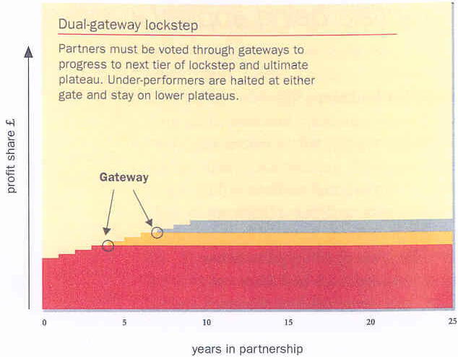
Dual-gateway lockstep
Source: Commercial Lawyer

Slide 17
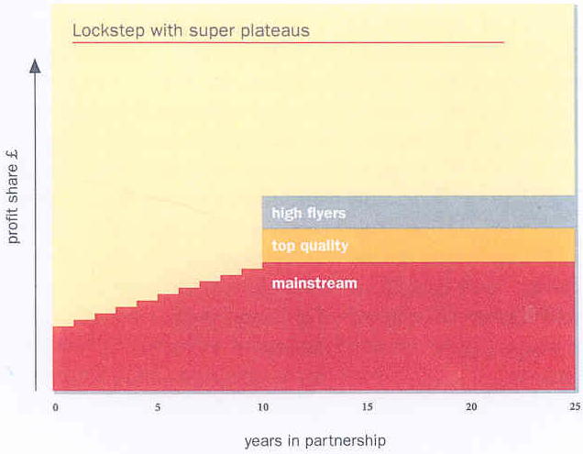
Lockstep with super plateaus
Source: Commercial Lawyer

Slide 18
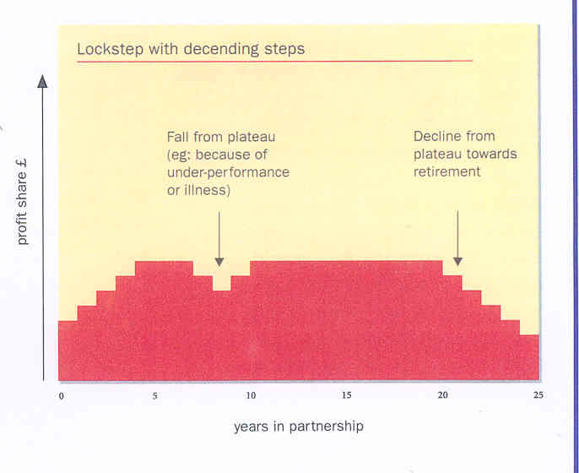
Lockstep with descending steps
Source: Commercial Lawyer

Slide 19
Modified lockstep
Source: Commercial Lawyer

Slide 20
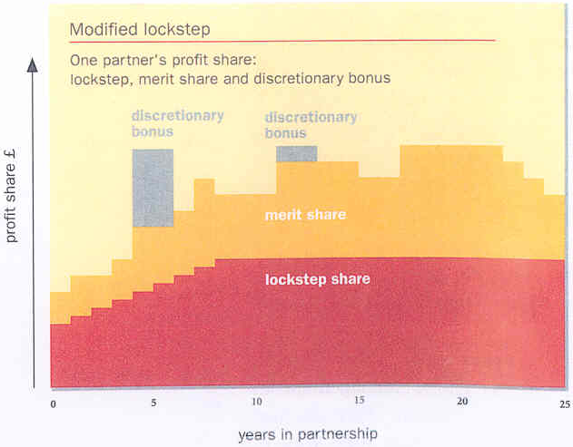
Modified lockstep with bonus
Source: Commercial Lawyer

Slide 21
Lockstep?
Traditional and variants
Advantages / disadvantages?
Outdated?
Age discrimination issues?

Slide 22
Performance based reward

Slide 23
Performance-based reward
Consistent with and advance the goals of firm
Determine the relative contribution of each partner with respect to other partners
Strong emphasis on merit and performance (but not only financial performance)
No compensation system can make up for lack of profits

Slide 24
A performance based system should ideally ....
Differentiate between higher and average performers
Not address under - performers

Slide 25
Elements of a performance-based system
Prospective
Establish individual partner goals and plans
Attempts to move partners to strengths and away from weaknesses
Emphasis on ‘a rising tide lifts all boats’

Slide 26
Elements
Stable
Sustained performance or lack thereof over [three] years
Not many moves up or down
Large amounts between levels e.g. 15%

Slide 27
How do you measure performance?

Slide 28
Performance criteria
Designed to advance a firm’s goals:
Developing people
Developing client service
Managing and enhancing a firm’s reputation
Developing market share
Developing profitability

Slide 29
A U.S. firm example
The most important single factor in its evaluation is:
‘which partner/partners passed you most work last year?’

Slide 30
Some examples of performance criteria
Client relationships
Technical ability
Commercial / financial awareness
Business development
Management
Relationships with colleagues
Personal attributes
“What will it take to succeed at our firm in the future?”
PETER SCOTT CONSULTING
Notes:
30

Slide 31
Performance based reward assessment criteria
Involve partners in clarifying criteria to define ‘high performance’
Partners will then feel they ‘own’ the process
Will provide greater transparency for future partners
PETER SCOTT CONSULTING
Notes:
31

Slide 32
Appraisals / Performance development reviews
Do you have a partner appraisal system?
How effective is it?

Slide 33
Appraisals
Need to be part of an on going performance management process
Should aim to provide each partner with an agreed and actionable performance development plan
Forms basis for performance based reward
PETER SCOTT CONSULTING
Notes:
33

Slide 34
Who should appraise?
Feedback from only those you report to ?
How effective are traditional appraisals?

Slide 35
Or a 360 degree appraisal?
Involves
Feedback from those you report to
Feedback from your peers
Feedback from staff who report to you
to provide an all-round perspective of
performance.
PETER SCOTT CONSULTING
Notes:
35

Slide 36
The 360° process
PETER SCOTT CONSULTING
Notes:
36

Slide 37
Why 360 degree feedback?
More constructive
Better received
More effective to enhance performance or change behaviour
than downward feedback alone
PETER SCOTT CONSULTING
Notes:
37

Slide 38
Obtaining feedback from colleagues can be an essential stage…
to build on peoples’ strengths and to reinforce what they are already doing well
to identify what they could do better
To form the basis for reward
PETER SCOTT CONSULTING
Notes:
38

Slide 39
Why better?
Who better to give feedback on
peoples’ performance and their people
management skills than their peers and
staff?
PETER SCOTT CONSULTING
Notes:
39

Slide 40
How to introduce 360° feedback into a law firm partnership?
Do not seek to impose it on partners
Partners must fully support the process if they are to take feedback to heart and change as a result
The process must not be seen as threatening
PETER SCOTT CONSULTING
Notes:
40

Slide 41
Developing a 360° appraisal
Involve partners in the development of the process
Explain
- purpose
- benefits
- how it will work
Tailor the process to their firm and its needs
PETER SCOTT CONSULTING
Notes:
41

Slide 42
The 360° process
No single best way to do this
Which way best suits your firm
Must be a process to which partners are willing to commit
PETER SCOTT CONSULTING
Notes:
42

Slide 43
For example….
Integrated into appraisals as part of annual performance management and reward cycle
Used to support a particular development programme
PETER SCOTT CONSULTING
Notes:
43

Slide 44
The debriefing process
Success depends on a positive and motivational debrief with each partner
Partners need to see any less than positive comments
- not as criticisms
- but as constructive comments to help
improve performance or change behaviour
PETER SCOTT CONSULTING
Notes:
44

Slide 45
How to manage a performance based reward system
Factors need to be communicated to and understood by partners
Who decides?
- trust is essential
- management must have significant
representation and influence
- involve non-management trusted
individuals for checks and balances

Slide 46
Transition from one system to another
Very difficult
Communicate
Minimise changes first year
Go slowly
Above all, communicate

Slide 47
A final thought …
Sanctions
Necessary?
Choice of sanctions?
Do they work?
Examples?

Slide 48
Any questions?

